Slide 1
Introduction to glomerular disease by, Dr.Mahadevi A.L Assistant Professor Dept of Paediatrics 3-07-2021

Slide 2
Anatomy of the glomerulus:
The two kidneys are bean-shaped organs located in the retroperitoneal space slightly above the level of the umbilicus.
Length is 6cm and weight is 24g in a full term newborn
Length is >12cm and weight is 150g in an adult.
Kidney has an oute rlayer cortex-contains glomeruli, proximal and distal convoluted tubules and collecting ducts
Inner layer medulla- contains straight portion of the tubules ,loop of henle, the vasa recta, and the terminal collecting ducts.

Slide 3
Blood enters the kidneys through arteries that branch inside the kidneys into tiny clusters of looping blood vessels. Each cluster is called a glomerulus, which comes from the Greek word meaning filter.
The plural form of the word is glomeruli.
There are approximately 1 million glomeruli, or filters, in each kidney.
The glomerulus is attached to the opening of a small fluid-collecting tube called a tubule.
Blood is filtered in the glomerulus, and extra fluid and wastes pass into the tubule and become urine.
Eventually, the urine drains from the kidneys into the bladder through larger tubes called ureters.

Slide 5
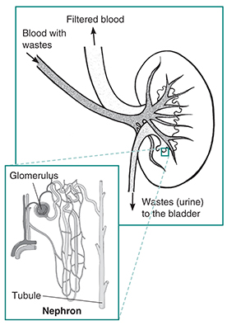

Slide 6
Each glomerulus-and-tubule unit is called a nephron.
Each kidney is composed of about 1 million nephrons.
In healthy nephrons, the glomerular membrane that separates the blood vessel from the tubule allows waste products and extra water to pass into the tubule while keeping blood cells and protein in the bloodstream.

Slide 8
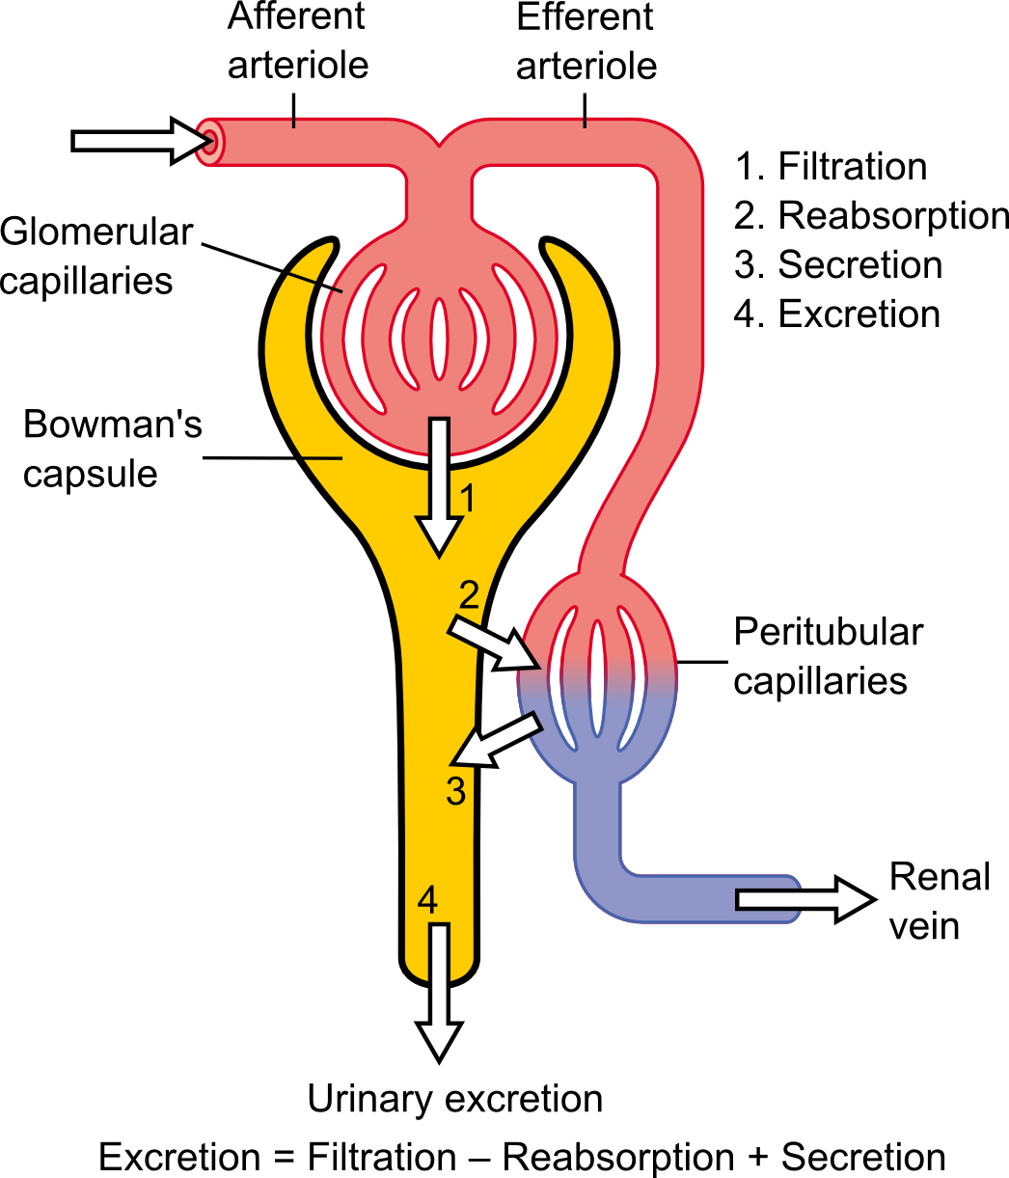

Slide 10
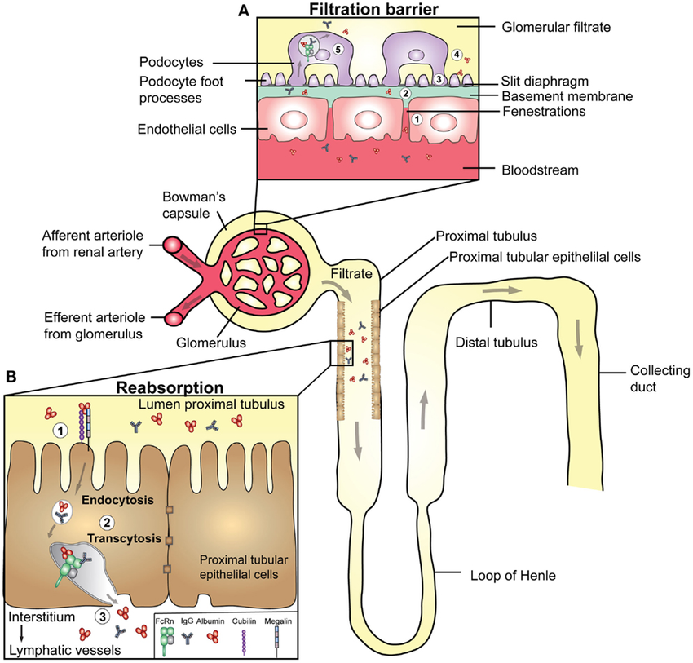

Slide 11
Terminology of glomerular diseases
Primary: a kidney disease specifically affecting the glomeruli(e.g., minimal change glomerulonephritis)
Secondary: a disease affecting the glomeruli in the context of a systemic disease (e.g., lupus nephritis in SLE) or a disease affecting another organ (e.g., diabetic nephropathy)
Diffuse: > 50% of glomeruli affected (e.g., diffuse proliferative glomerulonephritis)
Focal: < 50% of glomeruli affected (e.g., focal segmental glomerulosclerosis)
Global: entire glomerulus is affected
Segmental: only part of the glomerulus is affected
Proliferative: an increased number of cells in the glomerulus
Membranous: thickening of the glomerular basement membrane (e.g., membranous nephropathy)
Sclerosing: scarring of the glomerulus
Necrotizing: cell death within the glomerulus
Crescentic: accumulation of cells such as macrophages, fibroblasts, and epithelial cells in Bowman space

Slide 12
Glomerular diseases damage the glomeruli, letting protein and sometimes red blood cells leak into the urine.
Sometimes a glomerular disease also interferes with the clearance of waste products by the kidney, so they begin to build up in the blood.
Furthermore, loss of blood proteins like albumin in the urine can result in a fall in their level in the bloodstream.
In normal blood, albumin acts like a sponge, drawing extra fluid from the body into the bloodstream, where it remains until the kidneys remove it.
But when albumin leaks into the urine, the blood loses its capacity to absorb extra fluid from the body.
Fluid can accumulate outside the circulatory system in the face, hands, feet, or ankles and cause swelling.

Slide 13
The glomerular filtration barrier consists of 3 parts
Initial segment: Fenestrated glomerular capillary endothelium prevents large proteins from passing through.
Second segment: The glomerular basement membrane (GBM contains a negative charge produced by heparan sulfate
Final segment: Visceral epithelial cells produce/maintain the GBM and contain intercellular junctions created by podocyte that prevent further protein loss.

Slide 18
Damage to the glomeruli
→ disruption of the glomerular filtration barrier → can lead to nephritic or nephrotic syndrome

Slide 19
Signs and Symptoms of glomerular disease include
albuminuria: large amounts of protein in the urine
hematuria: blood in the urine
reduced glomerular filtration rate: inefficient filtering of wastes from the blood
hypoproteinemia: low blood protein
edema: swelling in parts of the body

Slide 20
One or more of these symptoms can be the first sign of kidney disease.
But some of these symptoms have signs, or visible manifestations:
Proteinuria may cause foamy urine.
Blood may cause the urine to be pink or cola-colored.
Edema may be obvious in hands and ankles, especially at the end of the day, or around the eyes when awakening in the morning, for example

Slide 21
DIAGNOSIS:
Patients with glomerular disease have significant amounts of protein in the urine, which may be referred to as "nephrotic range" if levels are very high.
Red blood cells in the urine are a frequent finding as well, particularly in some forms of glomerular disease.
Urinalysis provides information about kidney damage by indicating levels of protein and red blood cells in the urine.
Blood tests measure the levels of waste products such as creatinine and urea nitrogen to determine whether the filtering capacity of the kidneys is impaired.
If these lab tests indicate kidney damage, the doctor may recommend ultrasound or an x-ray to see whether the shape or size of the kidneys is abnormal. These tests are called renal imaging.
Glomerular disease causes problems at the cellular level, kidney biopsy—a procedure in which a needle is used to extract small pieces of tissue for examination with different types of microscopes, each of which shows a different aspect of the tissue.
A biopsy may be helpful in confirming glomerular disease and identifying the cause.

Slide 22
Causes of glomerular diseases
A number of different diseases can result in glomerular disease. It may be the direct result of an infection or a drug toxic to the kidneys, or it may result from a disease that affects the entire body, like diabetes or lupus.
Many different kinds of diseases can cause swelling or scarring of the nephron or glomerulus. Sometimes glomerular disease is idiopathic, meaning that it occurs without an apparent associated disease.
The categories presented below can overlap: that is, a disease might belong to two or more of the categories.
For example, diabetic nephropathy is a form of glomerular disease that can be placed in two categories: systemic diseases, since diabetes itself is a systemic disease, and sclerotic diseases, because the specific damage done to the kidneys is associated with scarring.

Slide 23
Autoimmune Diseases
When the body's immune system functions properly, it creates protein-like substances called antibodies and immunoglobulins to protect the body against invading organisms.
In an autoimmune disease, the immune system creates autoantibodies, which are antibodies or immunoglobulins that attack the body itself.
Autoimmune diseases may be systemic and affect many parts of the body, or they may affect only specific organs or regions.

Slide 24
Systemic lupus erythematosus (SLE) affects many parts of the body: primarily the skin and joints, but also the kidneys. Because women are more likely to develop SLE than men, some researchers believe that a sex-linked genetic factor may play a part in making a person susceptible, although viral infection has also been implicated as a triggering factor.
Lupus nephritis is the name given to the kidney disease caused by SLE, and it occurs when autoantibodies form or are deposited in the glomeruli, causing inflammation.

Slide 25
Ultimately, the inflammation may create scars that keep the kidneys from functioning properly.
Conventional treatment for lupus nephritis includes a combination of two drugs, cyclophosphamide, a cytotoxic agent that suppresses the immune system, and prednisolone, a corticosteroid used to reduce inflammation.
A newer immunosuppressant, mychophenolate mofetil (MMF), has been used instead of cyclophosphamide. Preliminary studies indicate that MMF may be as effective as cyclophosphamide and has milder side effects.

Slide 26
Anti-GBM (Goodpasture's) disease
involves an autoantibody that specifically targets the kidneys and the lungs.
Often, the first indication that patients have the autoantibody is when they cough up blood. But lung damage in Goodpasture Syndrome is usually superficial compared with progressive and permanent damage to the kidneys.
Goodpasture Syndrome is a rare condition that affects mostly young men but also occurs in women, children, and older adults.
Treatments include immunosuppressive drugs and a blood-cleaning therapy called plasmapheresis that removes the autoantibodies.

Slide 27
IgA nephropathy
is a form of glomerular disease that results when immunoglobulin A (IgA) forms deposits in the glomeruli, where it creates inflammation.
IgA nephropathy was not recognized as a cause of glomerular disease until the late 1960s, when sophisticated biopsy techniques were developed that could identify IgA deposits in kidney tissue.
The most common symptom of IgA nephropathy is blood in the urine, but it is often a silent disease that may go undetected for many years.

Slide 28
The silent nature of the disease makes it difficult to determine how many people are in the early stages of IgA nephropathy, when specific medical tests are the only way to detect it.
This disease is estimated to be the most common cause of primary glomerulonephritis—that is, glomerular disease not caused by a systemic disease like lupus or diabetes mellitus.
It appears to affect men more than women. Although IgA nephropathy is found in all age groups, young people rarely display signs of kidney failure because the disease usually takes several years to progress to the stage where it causes detectable complications.

Slide 29
No treatment is recommended for early or mild cases of IgA nephropathy when the patient has normal blood pressure and less than 1 gram of protein in a 24-hour urine output.
When proteinuria exceeds 1 gram/day, treatment is aimed at protecting kidney function by reducing proteinuria and controlling blood pressure.
Blood pressure medicines—angiotensin—converting enzyme inhibitors (ACE inhibitors) or angiotensin receptor blockers (ARBs)—that block a hormone called angiotensin are most effective at achieving those two goals simultaneously.

Slide 30
Hereditary Nephritis—Alport Syndrome
The primary indicator of Alport syndrome is a family history of chronic glomerular disease, although it may also involve hearing or vision impairment.
This syndrome affects both men and women, but men are more likely to experience chronic kidney disease and sensory loss.
Men with Alport syndrome usually first show evidence of renal insufficiency while in their twenties and reach total kidney failure by age 40.
Women rarely have significant renal impairment, and hearing loss may be so slight that it can be detected only through testing with special equipment.
Usually men can pass the disease only to their daughters.
Women can transmit the disease to either their sons or their daughters.
Treatment focuses on controlling blood pressure to maintain kidney function.

Slide 31
Infection-related Glomerular Disease
Glomerular disease sometimes develops rapidly after an infection in other parts of the body.
Acute post-streptococcal glomerulonephritis (PSGN) can occur after an episode of strep throat or, in rare cases, impetigo (a skin infection).
The Streptococcus bacteria do not attack the kidney directly, but an infection may stimulate the immune system to overproduce antibodies, which are circulated in the blood and finally deposited in the glomeruli, causing damage.
PSGN can bring on sudden symptoms of swelling (edema), reduced urine output (oliguria), and blood in the urine (hematuria).
Tests will show large amounts of protein in the urine and elevated levels of creatinine and urea nitrogen in the blood, thus indicating reduced kidney function.
High blood pressure frequently accompanies reduced kidney function in this disease.
PSGN is most common in children between the ages of 3 and 7, although it can strike at any age, and it most often affects boys.
It lasts only a brief time and usually allows the kidneys to recover. In a few cases, however, kidney damage may be permanent, requiring dialysis or transplantation to replace renal function.

Slide 32
Bacterial endocarditis, infection of the tissues inside the heart, is also associated with subsequent glomerular disease.
Researchers are not sure whether the renal lesions that form after a heart infection are caused entirely by the immune response or whether some other disease mechanism contributes to kidney damage.
Treating the heart infection is the most effective way of minimizing kidney damage.
Endocarditis sometimes produces chronic kidney disease (CKD).
HIV, the virus that leads to AIDS, can also cause glomerular disease.
Between 5 and 10 percent of people with HIV experience kidney failure, even before developing full-blown AIDS.
HIV-associated nephropathy usually begins with heavy proteinuria and progresses rapidly (within a year of detection) to total kidney failure.
Researchers are looking for therapies that can slow down or reverse this rapid deterioration of renal function, but some possible solutions involving immunosuppression are risky because of the patients' already compromised immune system.

Slide 33
Sclerotic Diseases
Glomerulosclerosis is scarring (sclerosis) of the glomeruli. In several sclerotic conditions, a systemic disease like lupus or diabetes is responsible.
Glomerulosclerosis is caused by the activation of glomerular cells to produce scar material.
This may be stimulated by molecules called growth factors, which may be made by glomerular cells themselves or may be brought to the glomerulus by the circulating blood that enters the glomerular filter.
Diabetic nephropathy is the leading cause of glomerular disease and of total kidney failure in the United States.
Kidney disease is one of several problems caused by elevated levels of blood glucose, the central feature of diabetes.
In addition to scarring the kidney, elevated glucose levels appear to increase the speed of blood flow into the kidney, putting a strain on the filtering glomeruli and raising blood pressure.

Slide 34
Diabetic nephropathy usually takes many years to develop.
People with diabetes can slow down damage to their kidneys by controlling their blood glucose through healthy eating with moderate protein intake, physical activity, and medications.
People with diabetes should also be careful to keep their blood pressure at a level below 140/90 mm Hg, if possible.
Blood pressure medications called ACE inhibitors and ARBs are particularly effective at minimizing kidney damage and are now frequently prescribed to control blood pressure in patients with diabetes and in patients with many forms of kidney disease.

Slide 35
Focal segmental glomerulosclerosis (FSGS) describes scarring in scattered regions of the kidney, typically limited to one part of the glomerulus and to a minority of glomeruli in the affected region.
FSGS may result from a systemic disorder or it may develop as an idiopathic kidney disease, without a known cause.
Proteinuria is the most common symptom of FSGS, but, since proteinuria is associated with several other kidney conditions, the doctor cannot diagnose FSGS on the basis of proteinuria alone.
Biopsy may confirm the presence of glomerular scarring if the tissue is taken from the affected section of the kidney.
But finding the affected section is a matter of chance, especially early in the disease process, when lesions may be scattered.

Slide 36
Confirming a diagnosis of FSGS may require repeat kidney biopsies.
Arriving at a diagnosis of idiopathic FSGS requires the identification of focal scarring and the elimination of possible systemic causes such as diabetes or an immune response to infection.
Since idiopathic FSGS is, by definition, of unknown cause, it is difficult to treat. No universal remedy has been found, and most patients with FSGS progress to kidney failure over 5 to 20 years.

Slide 37
Some patients with an aggressive form of FSGS reach kidney failure in 2 to 3 years.
Treatments involving steroids or other immunosuppressive drugs appear to help some patients by decreasing proteinuria and improving kidney function.
But these treatments are beneficial to only a minority of those in whom they are tried, and some patients experience even poorer kidney function as a result.
ACE inhibitors and ARBs may also be used in FSGS to decrease proteinuria.
Treatment should focus on controlling blood pressure and blood cholesterol levels, factors that may contribute to kidney scarring.

Slide 38
Other Glomerular Diseases
Membranous nephropathy, also called membranous glomerulopathy, is the second most common cause of the nephrotic syndrome (proteinuria, edema, high cholesterol) in U.S. adults after diabetic nephropathy.
Diagnosis of membranous nephropathy requires a kidney biopsy, which reveals unusual deposits of immunoglobulin G and complement C3, substances created by the body's immune system.
Fully 75 percent of cases are idiopathic, which means that the cause of the disease is unknown.
The remaining 25 percent of cases are the result of other diseases like systemic lupus erythematosus, hepatitis B or hepatitis C infection, or some forms of cancer.
Drug therapies involving penicillamine, gold, or captopril have also been associated with membranous nephropathy.

Slide 39
About 20 to 40 percent of patients with membranous nephropathy progress, usually over decades, to kidney failure, but most patients experience either complete remission or continued symptoms without progressive kidney failure.
Doctors disagree about how aggressively to treat this condition, since about 20 percent of patients recover without treatment.
ACE inhibitors and ARBs are generally used to reduce proteinuria.
Additional medication to control high blood pressure and edema is frequently required. Some patients benefit from steroids, but this treatment does not work for everyone.
Additional immunosuppressive medications are helpful for some patients with progressive disease.

Slide 40
Minimal change disease (MCD) is the diagnosis given when a patient has the nephrotic syndrome and the kidney biopsy reveals little or no change to the structure of glomeruli or surrounding tissues when examined by a light microscope.
Tiny drops of a fatty substance called a lipid may be present, but no scarring has taken place within the kidney.
MCD may occur at any age, but it is most common in childhood.
A small percentage of patients with idiopathic nephrotic syndrome do not respond to steroid therapy.
For these patients, the doctor may recommend a low-sodium diet and prescribe a diuretic to control edema.
The doctor may recommend the use of nonsteroidal anti-inflammatory drugs to reduce proteinuria.
ACE inhibitors and ARBs have also been used to reduce proteinuria in patients with steroid-resistant MCD.
These patients may respond to larger doses of steroids, more prolonged use of steroids, or steroids in combination with immunosuppressant drugs, such as chlorambucil, cyclophosphamide, or cyclosporine.

Slide 41
Chronic Kidney Disease
Most forms of glomerular disease develop gradually, often causing no symptoms for many years.
Chronic kidney disease (CKD) is the slow, gradual loss of kidney function.
Some forms of CKD can be controlled or slowed down. For example, diabetic nephropathy can be delayed by tightly controlling blood glucose levels and using ACE inhibitors and ARBs to reduce proteinuria and control blood pressure.
But CKD cannot be cured.
Partial loss of renal function means that some portion of the patient's nephrons have been scarred, and scarred nephrons cannot be repaired.
In many cases, CKD leads to kidney failure.

Slide 42
Thank u

